Slide 1
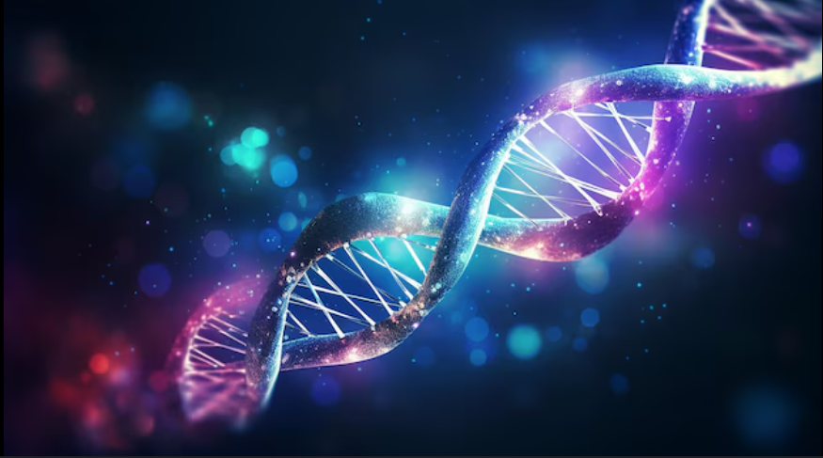
Cyto Auto Cluster
Enhancing Cytometry With
Deep Learning
By Likitha Dadi

Slide 2
TABLE OF CONTENTS
Problem Statement
Data Set
Challenges
Objectives
Methodologies
Encoder
t-SNE
Semi-Supervised Learning
Results
Gradio Interface - Live Demo
Conclusion
Thank You
1
2
3
4
5
6
7
8
9
10
11
12

Slide 3
Problem Statement
Cyto Auto Cluster aims to integrate semi-supervised learning approaches within cytometry workflows. By utilizing both labeled and unlabeled data, this project seeks to develop a robust clustering algorithm that can adaptively learn from the inherent structure of cytometric data. This innovative approach not only aims to enhance the accuracy of cell classification but also to reduce the reliance on extensive labeled datasets, which can be labor-intensive and time-consuming to create.
Page 03

Slide 4
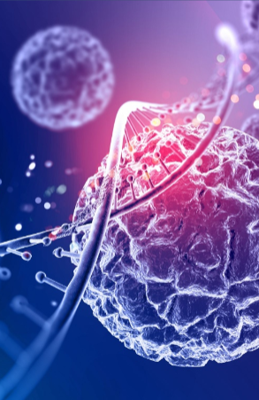
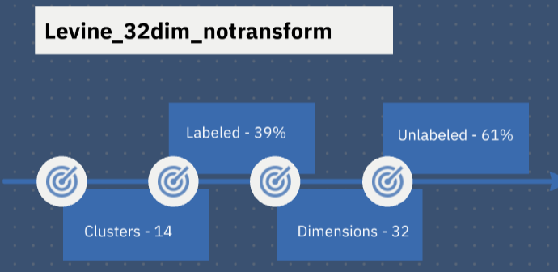
Data set
nmdbvjxcjvbdkj
Page 04

Slide 5
Challenges
HIGH DIMENSIONALITY
THOUSANDS OF FEATURES
SOLUTION: FEATURE SELECTION
01
LIMITED LABELED DATA AVAILABILITY
RARE CELL POPULATIONS
SOLUTION: SEMI-SUPERVISED LEARNING
03
02
NOISE IN DATA
Due to instrument variability or biological factors
SOLUTION : DATA AUGMENTATION
Page 05

Slide 6
Objectives
Develop a Semi-Supervised Framework
Improve Clustering Accuracy
Reduce Labeling Requirements
Enhance Interpretability
Scalability and Efficiency
Create an algorithm that can effectively utilize both labeled and unlabeled data to enhance clustering performance in cytometric analyses.
Implement deep learning techniques to achieve higher accuracy in classifying complex cell populations compared to traditional methods.
Minimize the need for extensive labeled datasets by leveraging unlabeled data, thereby reducing the time and resources required for data preparation.
Provide tools and visualizations that help researchers understand the clustering results and the underlying biological significance of identified cell populations.
Ensure that the developed algorithm is scalable and efficient, capable of handling large datasets commonly encountered in cytometry.
Page 06

Slide 7
Methodologies
DIMENSIONALITY REDUCTION TECHNIQUES
DATA AUGMENTATION
EDA
CLASSIFICATION
Box Plot
Correlation Matrix
Kurtosis
Skewness
Logistic Regression
XGBoost
PCA
t-SNE
Log Loss
Binary Masking
Corruption data
Page 07

Slide 8
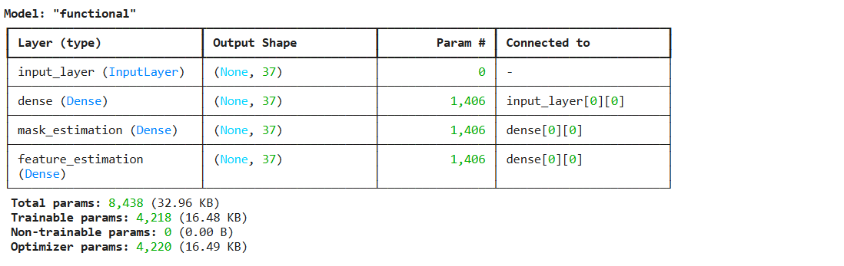
ENCODER
Encoders in a dataset are techniques used to convert categorical variables into numerical formats, making them suitable for machine learning algorithms. Common methods include one-hot encoding, which creates binary columns for each category, and label encoding, which assigns a unique integer to each category.
Page 08

Slide 9
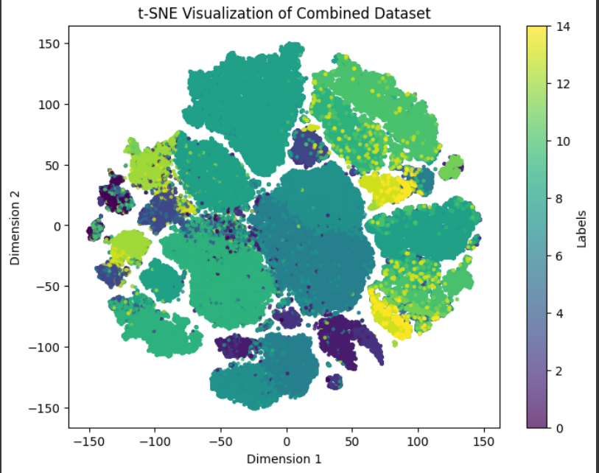
t-SNE
t-Distributed Stochastic Neighbor Embedding (t-SNE) is used for visualizing high-dimensional data in a low-dimensional space, typically 2D or 3D.t-SNE preserves the local structure of data, so similar points in the high-dimensional space stay close in the visualization. It does this by minimizing the differences in probability distributions of point distances between high and low dimensions, resulting in clusters that reflect the original relationships.
Page 09

Slide 10
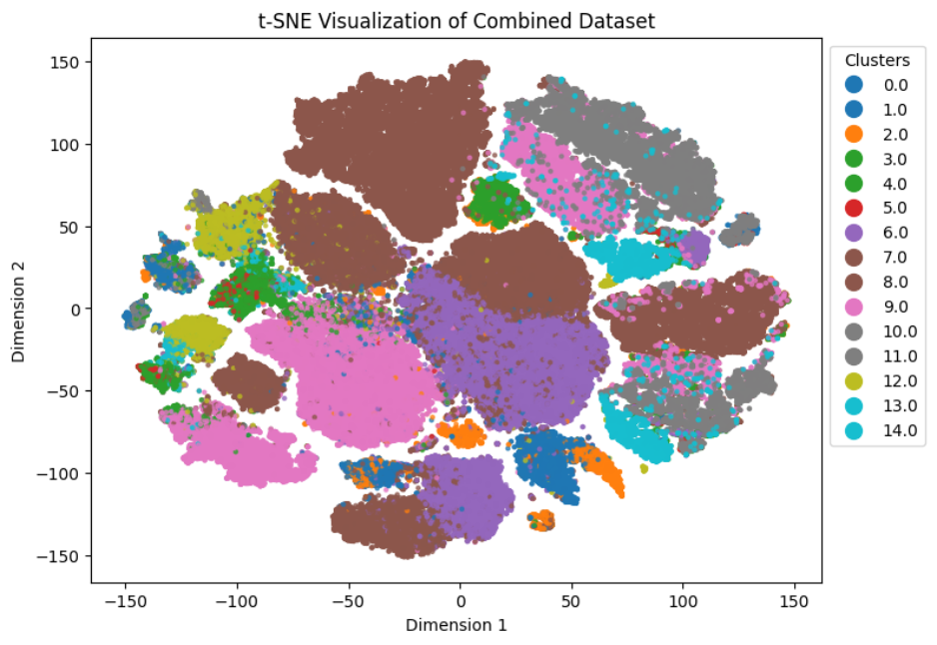
Semi-Supervised Learning
Validation Loss: 0.6611, Total Loss: 0.1747
We perform semi-supervised learning framework combining labeled and unlabeled data. It uses a custom neural network trained with supervised and unsupervised losses, balancing them with a beta parameter. An encoder extracts features from the data, and the model is trained in batches over multiple epochs. Finally, the trained model generates predictions for test data.
The Modified Cluster Values are visualized by performing t-SNE on the new data.
Page 10

Slide 11
Results
Logistic Regression Log Loss
XGBoost Log Loss
before encoding: 0.02989, after encoding: 0.0649
before encoding :0.003949, after encoding : 0.0073
Encoder : ( for 37 Features )
Self-Supervised Model
Validation Loss: 0.6611, Total Loss: 0.1747, Accuracy: 93.54%, AUROC: 99.09%
Total params: 8,438 (32.96 KB), Trainable params: 4,218 (16.48 KB), Non-trainable params: 0 (0.00 B), Optimizer params: 4,220 (16.49 KB)
Page 11

Slide 12
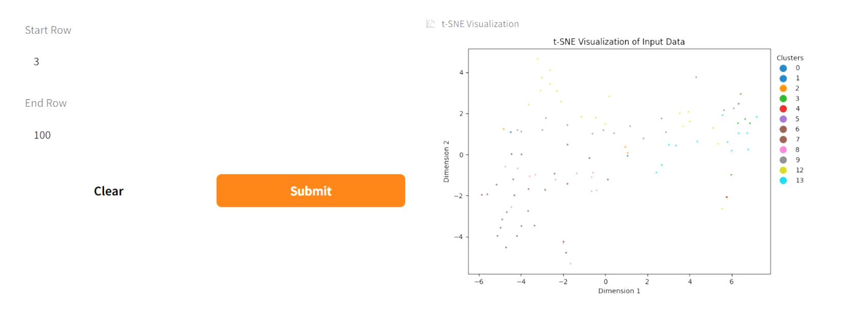
Page 12

Slide 13
Gradio Interface For User Interaction
The Visual Representation of Gradio Interface for our model is showcased in the below live demo video.
Live Demo Access Link :
Click Here
Page 13

Slide 14
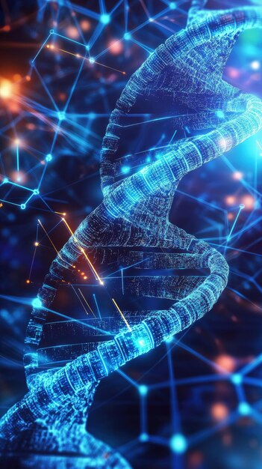
Conclusion
Integrates semi-supervised learning into cytometry workflows.
Combines labeled and unlabeled data for adaptive clustering.
Enhances cell classification accuracy while reducing reliance on labeled datasets.
Enables efficient, scalable, and precise cytometric analysis.
Page 14

Slide 15
Thank You.
Email : likithadadi08@gmail.com
Linked In : www.linkedin.com/in/dadilikitha
GitHub : https://github.com/LIKITHAADADI/

